Slide 1


Azərbaycan Dövlət Neft və Sənaye Universiteti
Calculus
Multivariable

Slide 2
Complex Numbers –
Polar Form

Slide 3
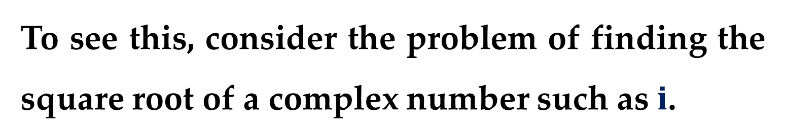
At this point we can add, subtract, multiply, and divide complex numbers.
However, there is still one basic procedure that is missing from our algebra of complex numbers.
To see this, consider the problem of finding the square root of a complex number such as $i$.

Slide 4
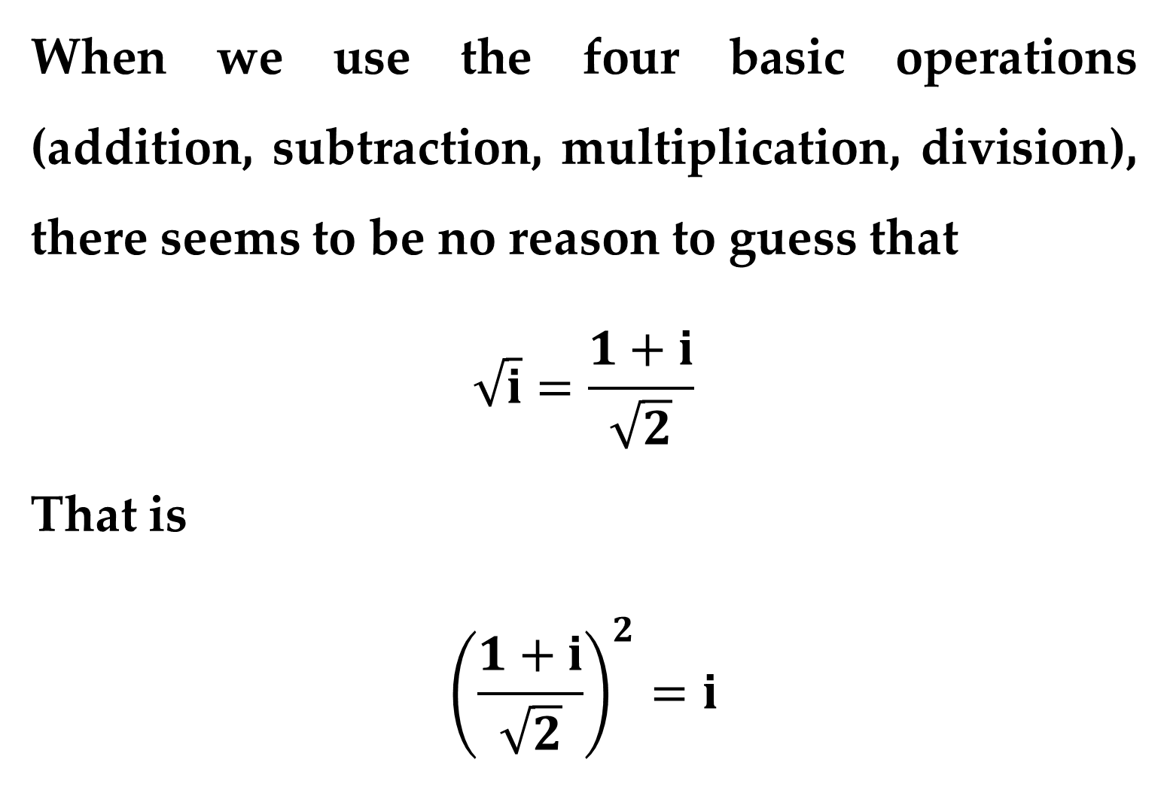
When we use the four basic operations (addition, subtraction, multiplication, division), there seems to be no reason to guess that
$$\sqrt{i}=\frac{1+i}{\sqrt{2}}$$
That is
$${\left(\frac{1+i}{\sqrt{2}}\right)}^{2}=i$$

Slide 5
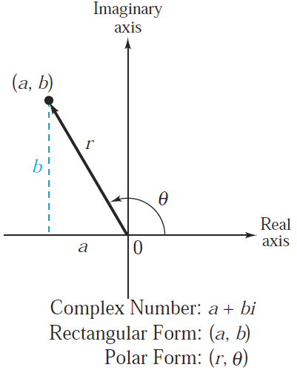
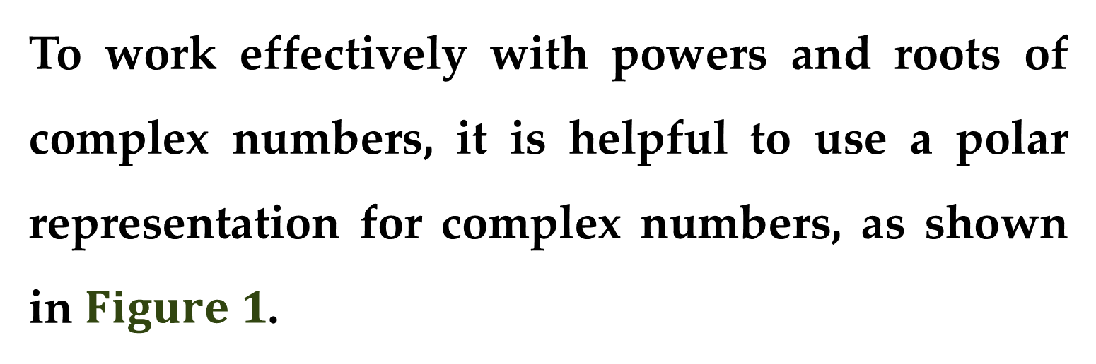
To work effectively with powers and roots of complex numbers, it is helpful to use a polar representation for complex numbers, as shown in $Figure 1$.

Slide 6
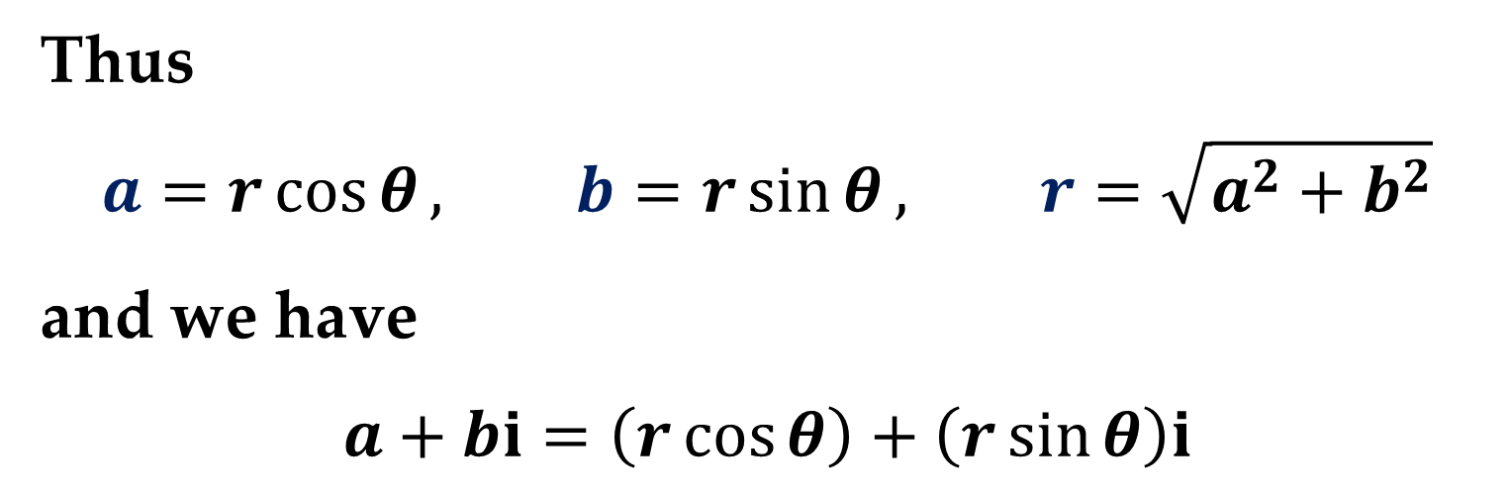
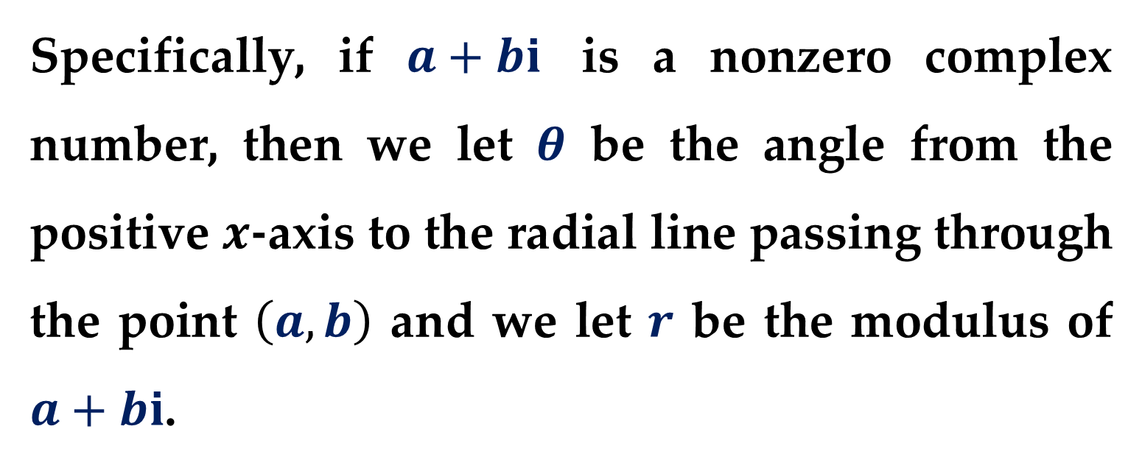
Specifically, if $a+bi$ is a nonzero complex number, then we let $θ$ be the angle from the positive $x$-axis to the radial line passing through the point $\left(a, b\right)$ and we let $r$ be the modulus of $a+bi$.
Thus
$$a=r\cos{θ}, b=r\sin{θ}, r=\sqrt{a^{2}+b^{2}}$$
and we have
$$a+bi=\left(r\cos{θ}\right)+\left(r\sin{θ}\right)i$$

Slide 7
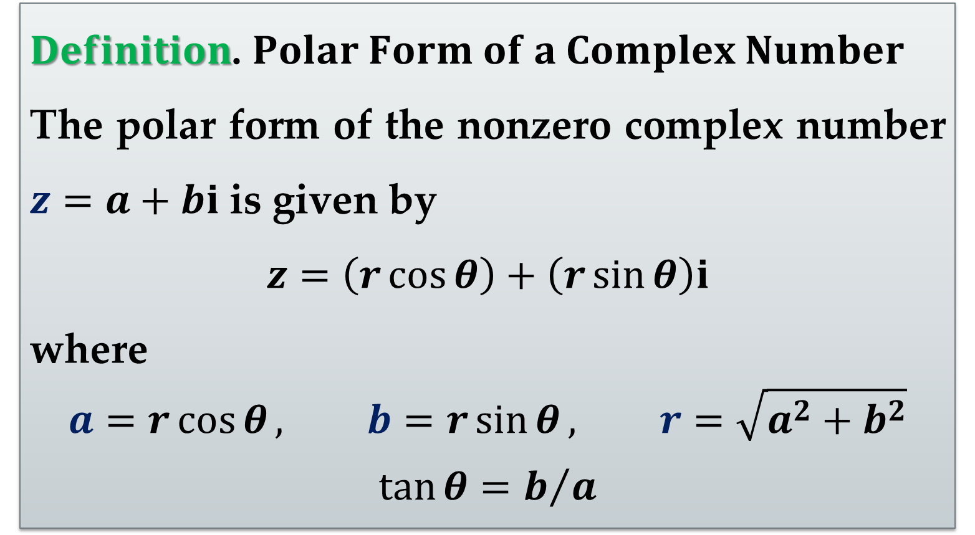
From this representation we obtain the following polar form of a complex number.
$Definition$. $Polar Form of a Complex Number$
The polar form of the nonzero complex number $z=a+bi$ is given by
$$z=\left(r\cos{θ}\right)+\left(r\sin{θ}\right)i$$
where
$$a=r\cos{θ}, b=r\sin{θ}, r=\sqrt{a^{2}+b^{2}}$$
$$\tan{θ}=b/a$$

Slide 8
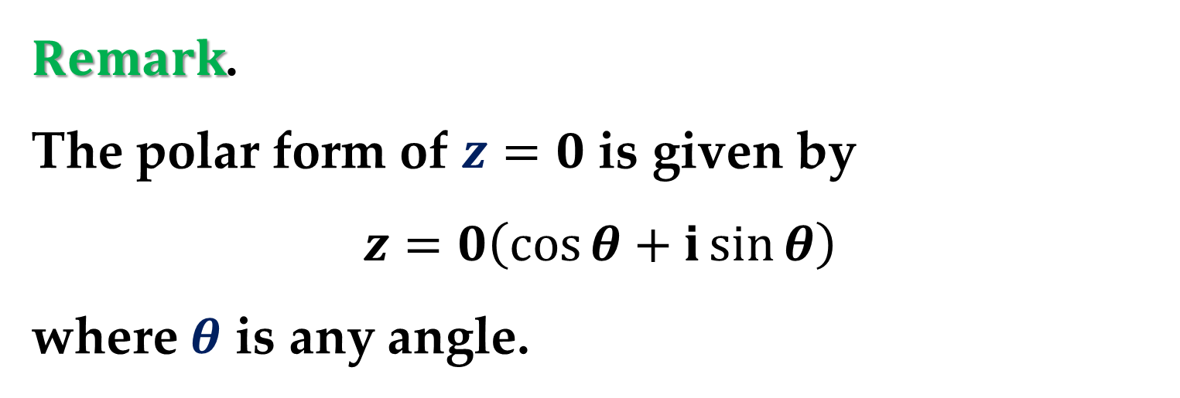
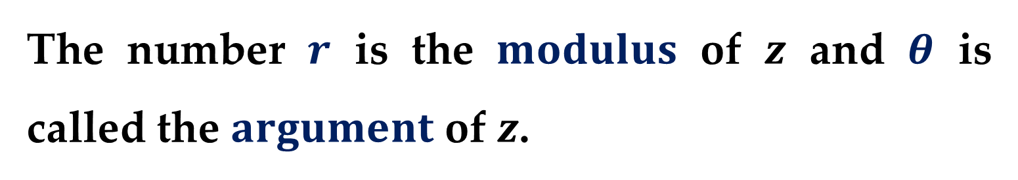
The number $r$ is the $modulus$ of $z$ and $θ$ is called the $argument$ of $z$.
$Remark$.
The polar form of $z=0$ is given by
$$z=0\left(\cos{θ}+i\sin{θ}\right)$$
where $θ$ is any angle.
Because there are infinitely many choices for the argument, the polar form of a complex number is not unique.

Slide 9
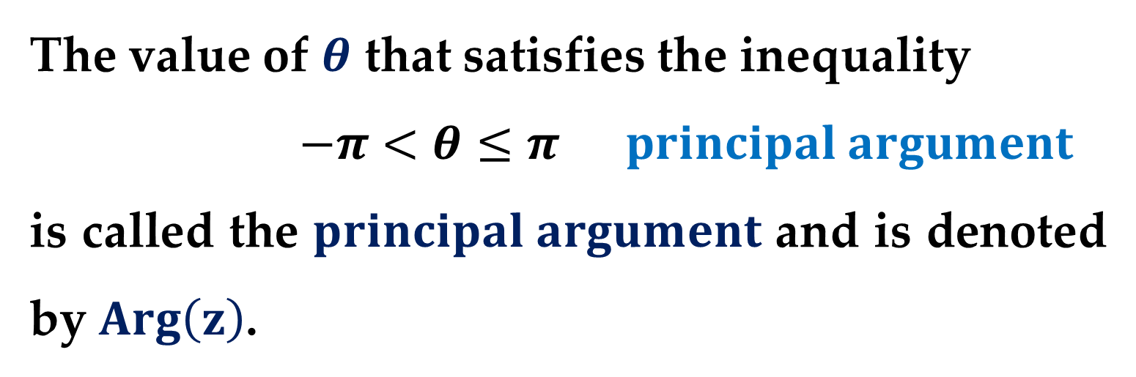
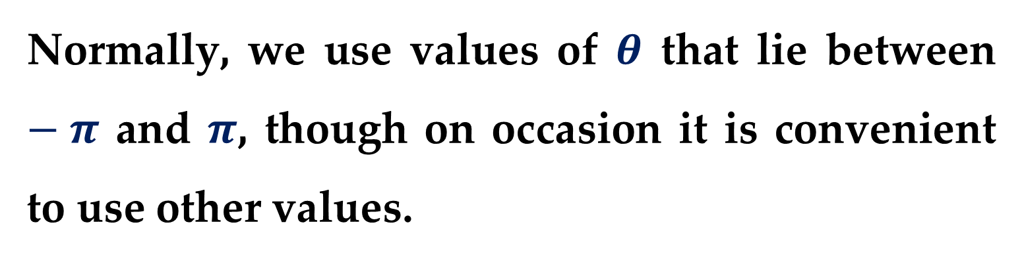
Normally, we use values of $θ$ that lie between $−π$ and $π$, though on occasion it is convenient to use other values.
The value of $θ$ that satisfies the inequality
$$−π<θ≤π principal argument$$
is called the $principal argument$ and is denoted by $Arg\left(z\right)$.

Slide 10
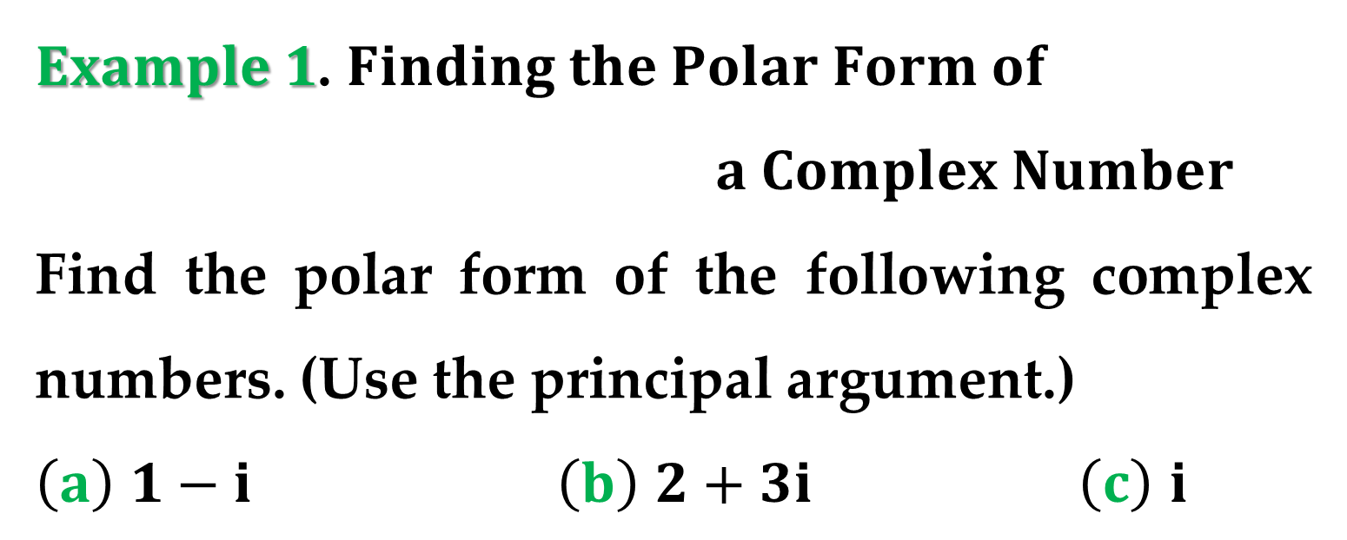
Two nonzero complex numbers in polar form are equal if and only if they have the same modulus and the same principal argument.
$Example 1$. $Finding the Polar Form of$
$a Complex Number$
Find the polar form of the following complex numbers. (Use the principal argument.)
$\left(a\right)$ $1−i$ $\left(b\right)$ $2+3i$ $\left(c\right)$ $i$

Slide 11
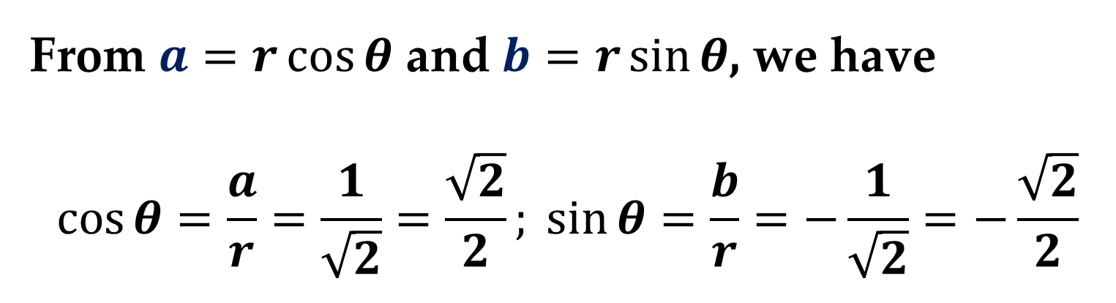
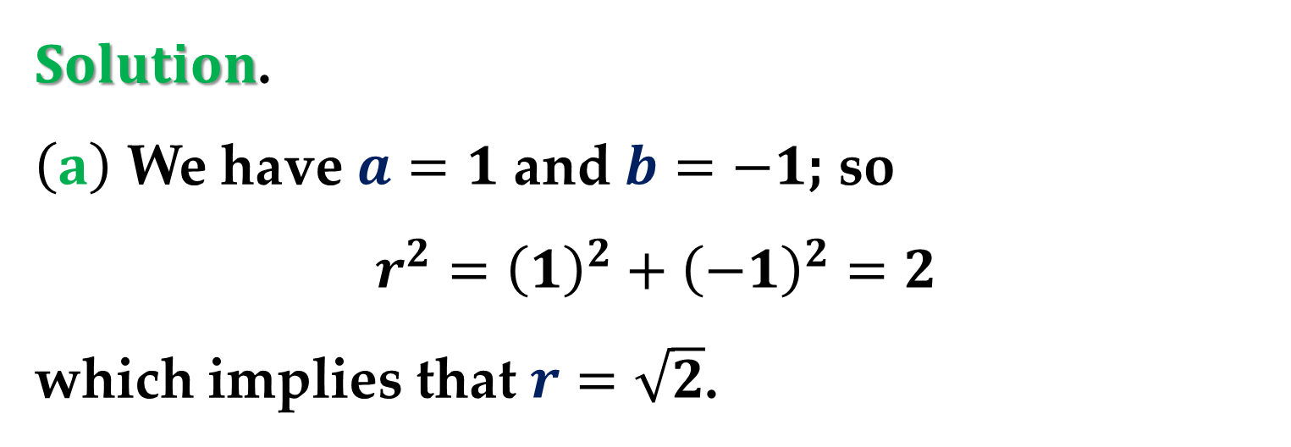
$Solution$.
$\left(a\right)$ We have $a=1$ and $b=−1$; so
$$r^{2}={\left(1\right)}^{2}+{\left(−1\right)}^{2}=2$$
which implies that $r=\sqrt{2}$.
From $a=r\cos{θ}$ and $b=r\sin{θ}$, we have
$$\cos{θ}=\frac{a}{r}=\frac{1}{\sqrt{2}}=\frac{\sqrt{2}}{2}; \sin{θ}=\frac{b}{r}=−\frac{1}{\sqrt{2}}=−\frac{\sqrt{2}}{2}$$

Slide 12
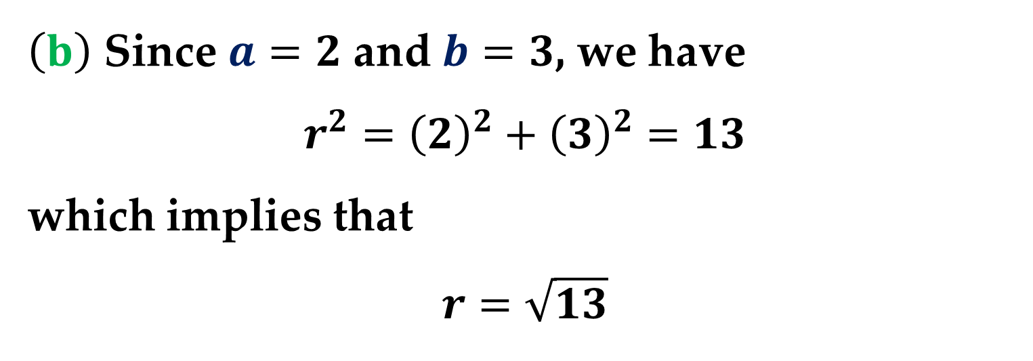
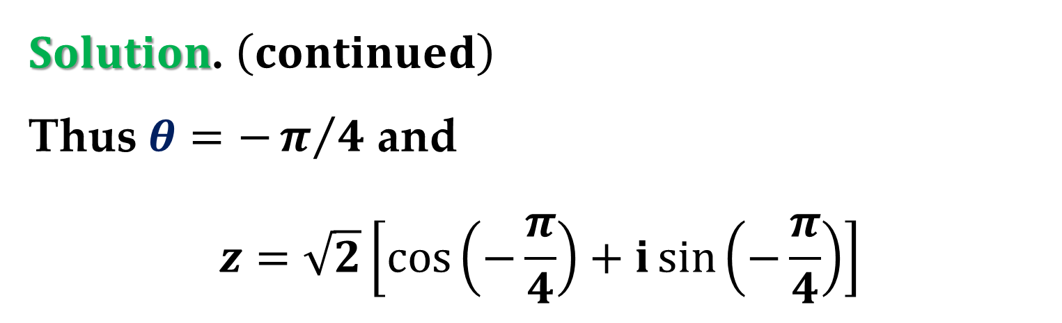
$Solution$. $\left(continued\right)$
Thus $θ=−π/4$ and
$$z=\sqrt{2}\left[\cos\left(−\frac{π}{4}\right)+i\sin\left(−\frac{π}{4}\right)\right]$$
$\left(b\right)$ Since $a=2$ and $b=3$, we have
$$r^{2}={\left(2\right)}^{2}+{\left(3\right)}^{2}=13$$
which implies that
$$r=\sqrt{13}$$

Slide 13
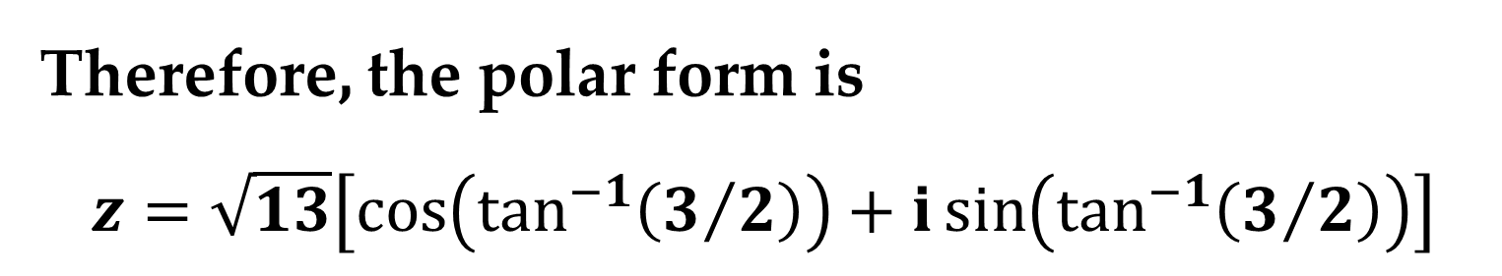
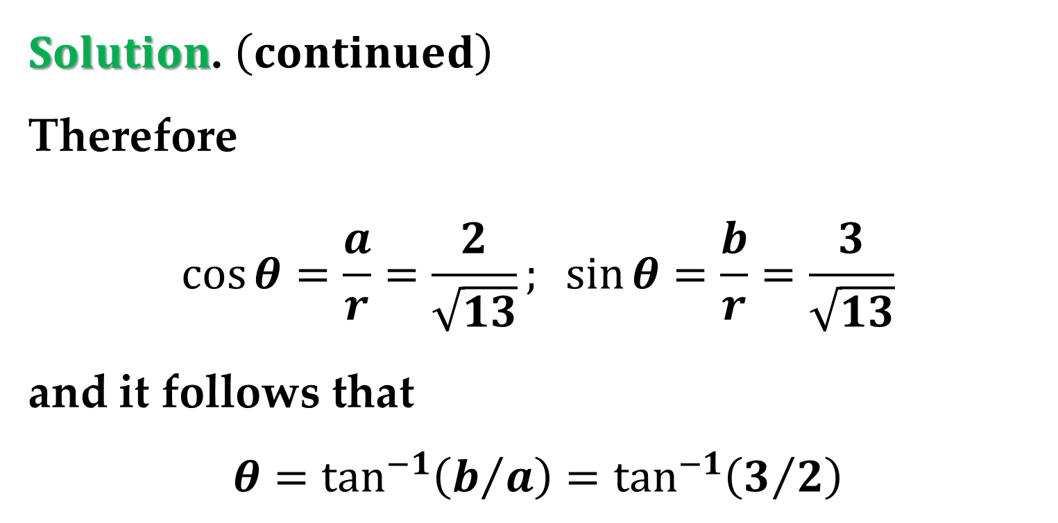
$Solution$. $\left(continued\right)$
Therefore
$$\cos{θ}=\frac{a}{r}=\frac{2}{\sqrt{13}}; \sin{θ}=\frac{b}{r}=\frac{3}{\sqrt{13}}$$
and it follows that
$$θ=\tan^{−1}\left(b/a\right)=\tan^{−1}\left(3/2\right)$$
Therefore, the polar form is
$$z=\sqrt{13}\left[\cos\left(\tan^{−1}\left(3/2\right)\right)+i\sin\left(\tan^{−1}\left(3/2\right)\right)\right]$$

Slide 14
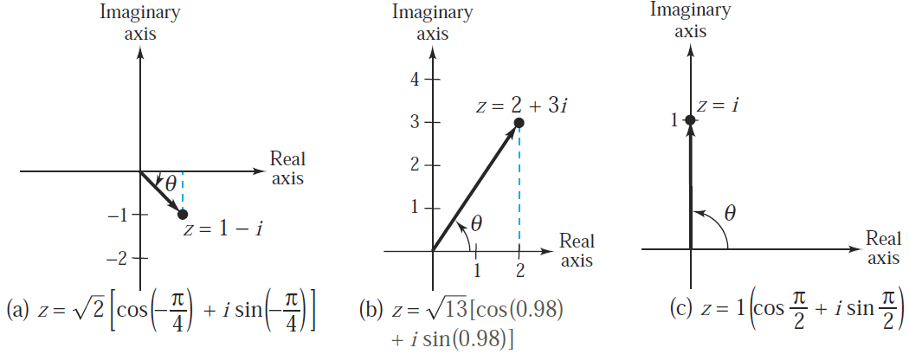
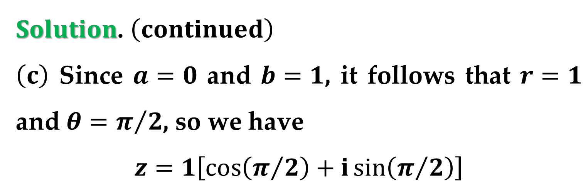
$Solution$. $\left(continued\right)$
$\left(c\right)$ Since $a=0$ and $b=1$, it follows that $r=1$ and $θ=π/2$, so we have
$$z=1\left[\cos\left(π/2\right)+i\sin\left(π/2\right)\right]$$

Slide 15
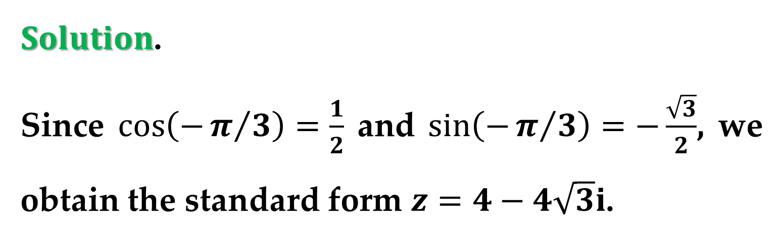
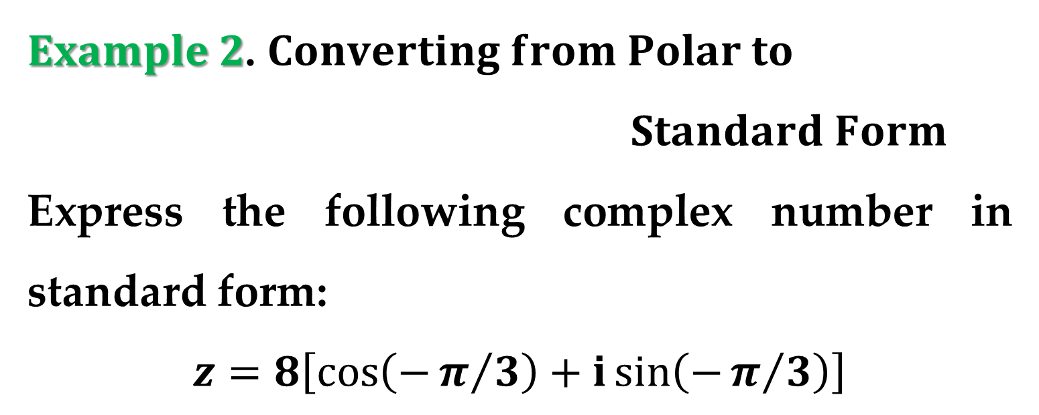
$Example 2$. $Converting from Polar to$
$Standard Form$
Express the following complex number in standard form:
$$z=8\left[\cos\left(−π/3\right)+i\sin\left(−π/3\right)\right]$$
$Solution$.
Since $\cos\left(−π/3\right)=\frac{1}{2}$ and $\sin\left(−π/3\right)=−\frac{\sqrt{3}}{2}$, we obtain the standard form $z=4−4\sqrt{3}i$.

Slide 16
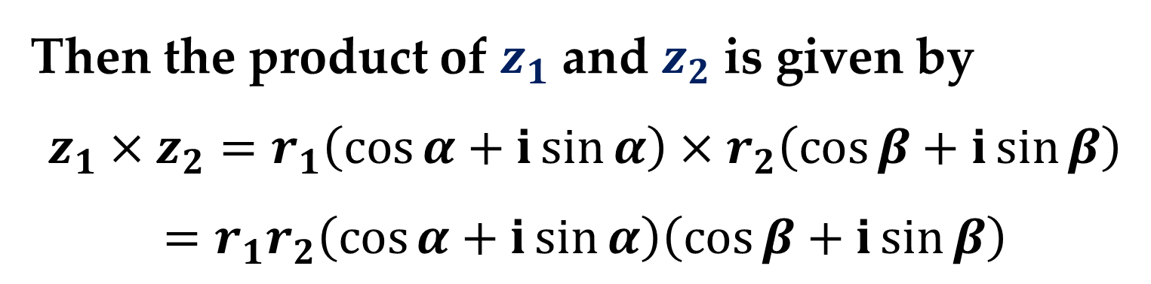
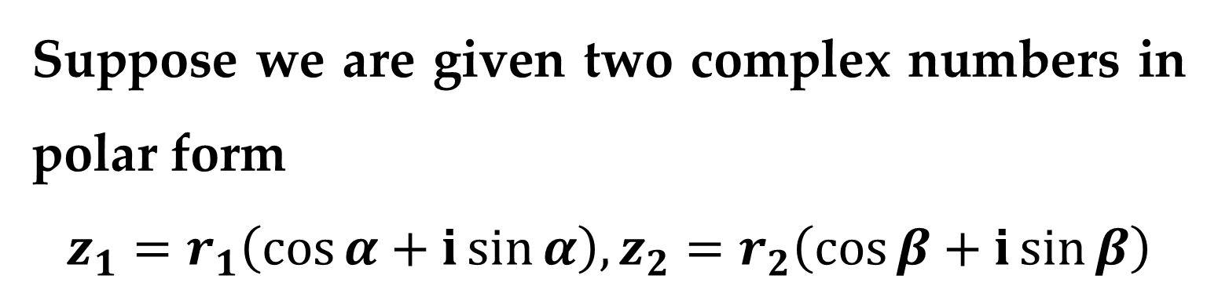
The polar form adapts nicely to multiplication and division of complex numbers.
Suppose we are given two complex numbers in polar form
$$z_{1}=r_{1}\left(\cos{α}+i\sin{α}\right), z_{2}=r_{2}\left(\cos{β}+i\sin{β}\right)$$
Then the product of $z_{1}$ and $z_{2}$ is given by
$$z_{1}×z_{2}=r_{1}\left(\cos{α}+i\sin{α}\right)×r_{2}\left(\cos{β}+i\sin{β}\right)$$
$$=r_{1}r_{2}\left(\cos{α}+i\sin{α}\right)\left(\cos{β}+i\sin{β}\right)$$

Slide 17
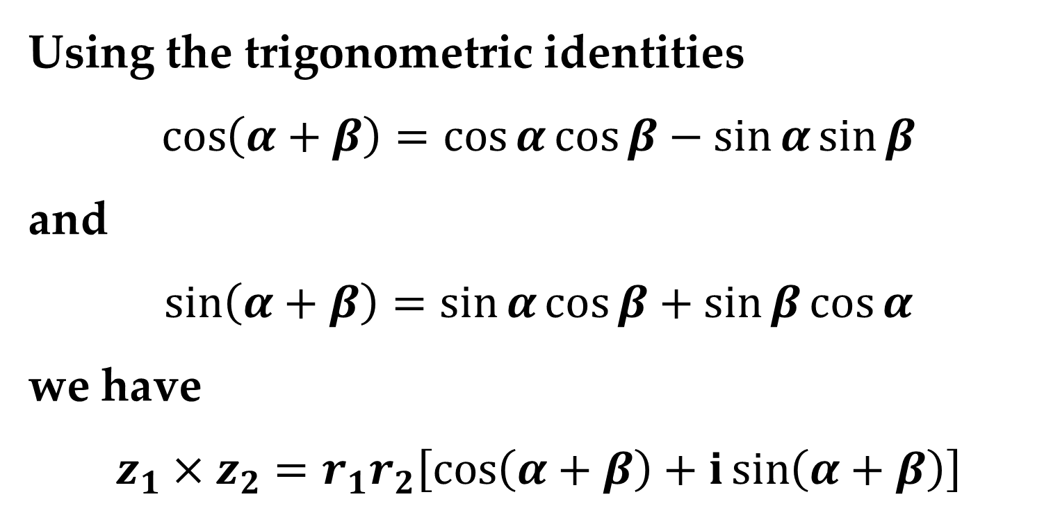

$$…=r_{1}r_{2}\left[\left(\cos{α}\cos{β}−\sin{α\sin{β}}\right)+\right.$$
$$\left.+i\left(\cos{α}\sin{β}+\sin{α}\cos{β}\right)\right]$$
Using the trigonometric identities
$$\cos\left(α+β\right)=\cos{α}\cos{β}−\sin{α\sin{β}}$$
and
$$\sin\left(α+β\right)=\sin{α}\cos{β}+\sin{β}\cos{α}$$
we have
$$z_{1}×z_{2}=r_{1}r_{2}\left[\cos\left(α+β\right)+i\sin\left(α+β\right)\right]$$

Slide 18
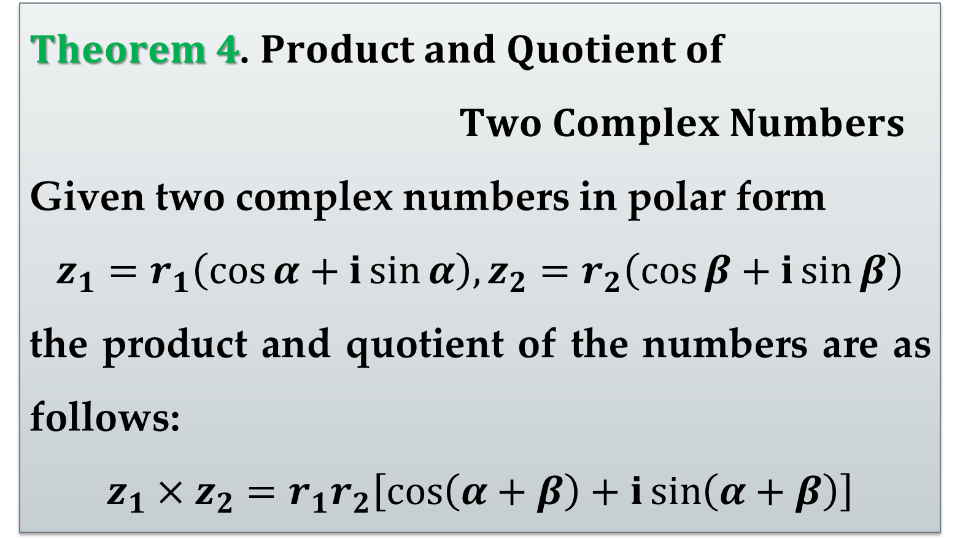
This establishes the first part of the following theorem.
$Theorem 4$. $Product and Quotient of$
$Two Complex Numbers$
Given two complex numbers in polar form
$$z_{1}=r_{1}\left(\cos{α}+i\sin{α}\right), z_{2}=r_{2}\left(\cos{β}+i\sin{β}\right)$$
the product and quotient of the numbers are as follows:
$$z_{1}×z_{2}=r_{1}r_{2}\left[\cos\left(α+β\right)+i\sin\left(α+β\right)\right]$$

Slide 19

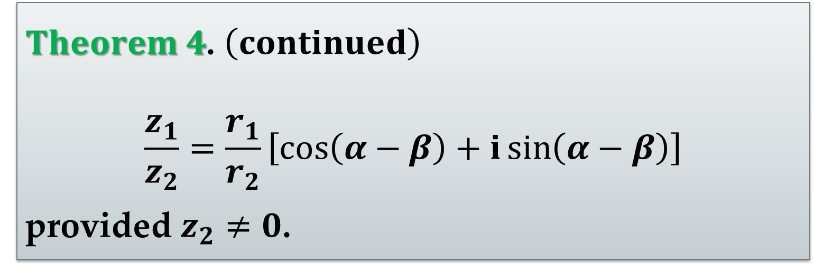
$Theorem 4$. $\left(continued\right)$
$$\frac{z_{1}}{z_{2}}=\frac{r_{1}}{r_{2}}\left[\cos\left(α−β\right)+i\sin\left(α−β\right)\right]$$
provided $z_{2}≠0$.
$Homework Assignment$:
The proof of the second part of this theorem is left to you as an exercise.

Slide 20
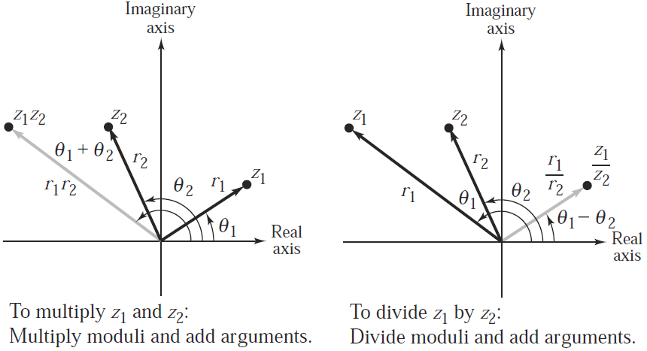
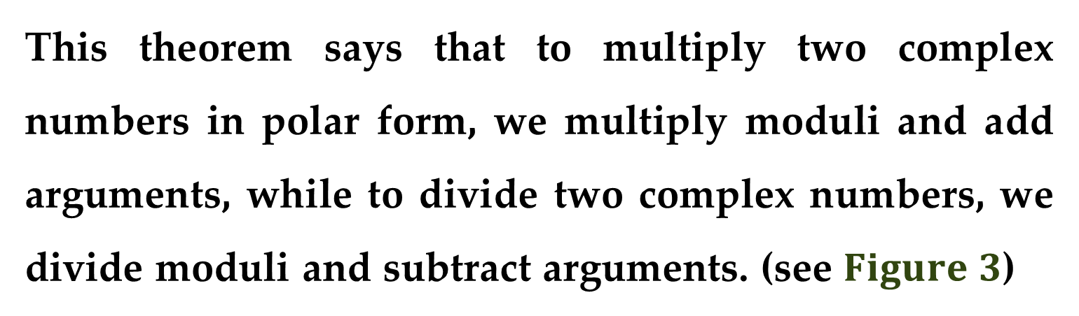
This theorem says that to multiply two complex numbers in polar form, we multiply moduli and add arguments, while to divide two complex numbers, we divide moduli and subtract arguments. (see $Figure 3$)

Slide 21
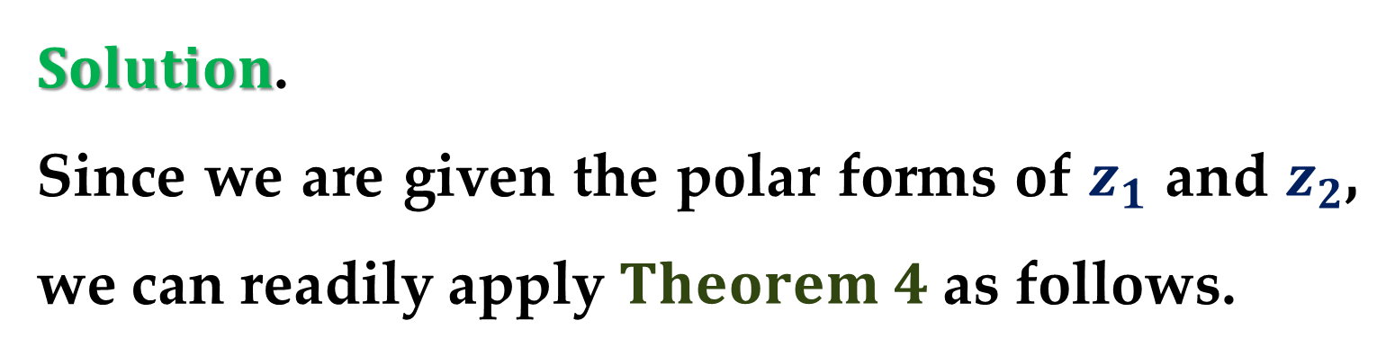
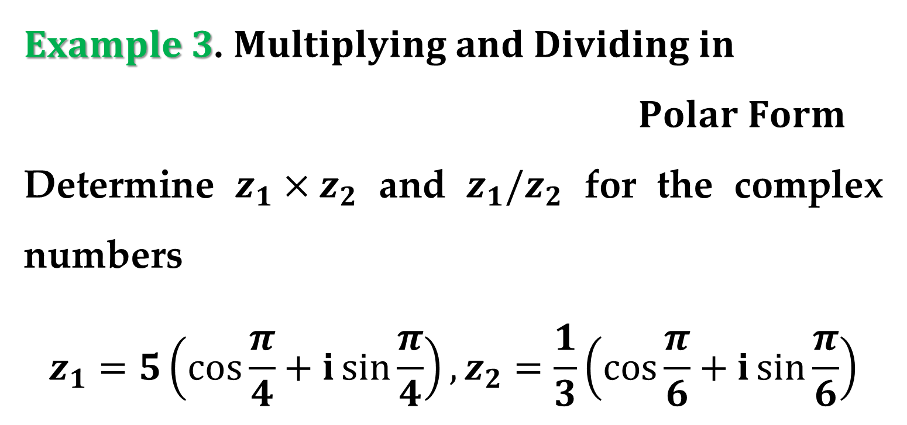
$Example 3$. $Multiplying and Dividing in$
$Polar Form$
Determine $z_{1}×z_{2}$ and $z_{1}/z_{2}$ for the complex numbers
$$z_{1}=5\left(\cos{\frac{π}{4}}+i\sin{\frac{π}{4}}\right), z_{2}=\frac{1}{3}\left(\cos{\frac{π}{6}}+i\sin{\frac{π}{6}}\right)$$
$Solution$.
Since we are given the polar forms of $z_{1}$ and $z_{2}$, we can readily apply $Theorem 4$ as follows.

Slide 22
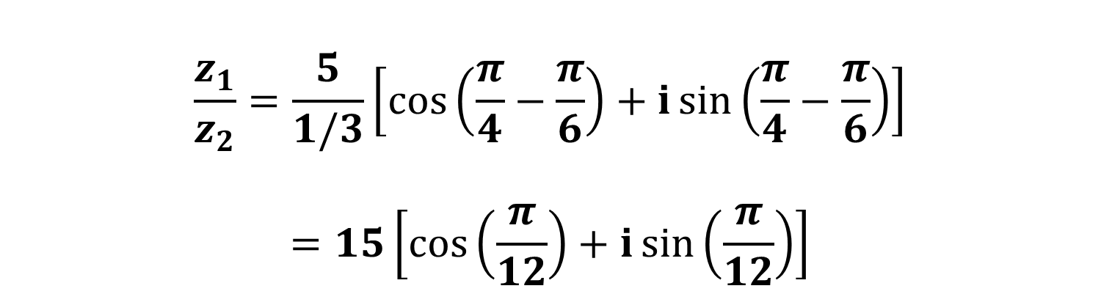
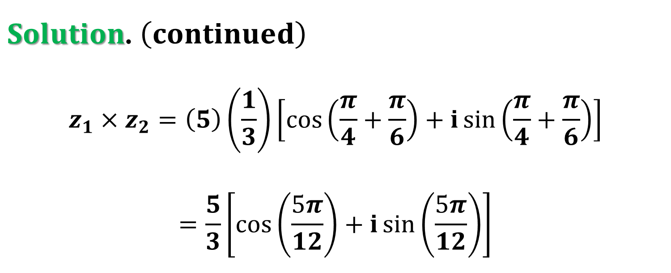
$Solution$. $\left(continued\right)$
$$z_{1}×z_{2}=\left(5\right)\left(\frac{1}{3}\right)\left[\cos\left(\frac{π}{4}+\frac{π}{6}\right)+i\sin\left(\frac{π}{4}+\frac{π}{6}\right)\right]$$
$$=\frac{5}{3}\left[\cos\left(\frac{5π}{12}\right)+i\sin\left(\frac{5π}{12}\right)\right]$$
$$\frac{z_{1}}{z_{2}}=\frac{5}{1/3}\left[\cos\left(\frac{π}{4}−\frac{π}{6}\right)+i\sin\left(\frac{π}{4}−\frac{π}{6}\right)\right]$$
$$=15\left[\cos\left(\frac{π}{12}\right)+i\sin\left(\frac{π}{12}\right)\right]$$

Slide 23
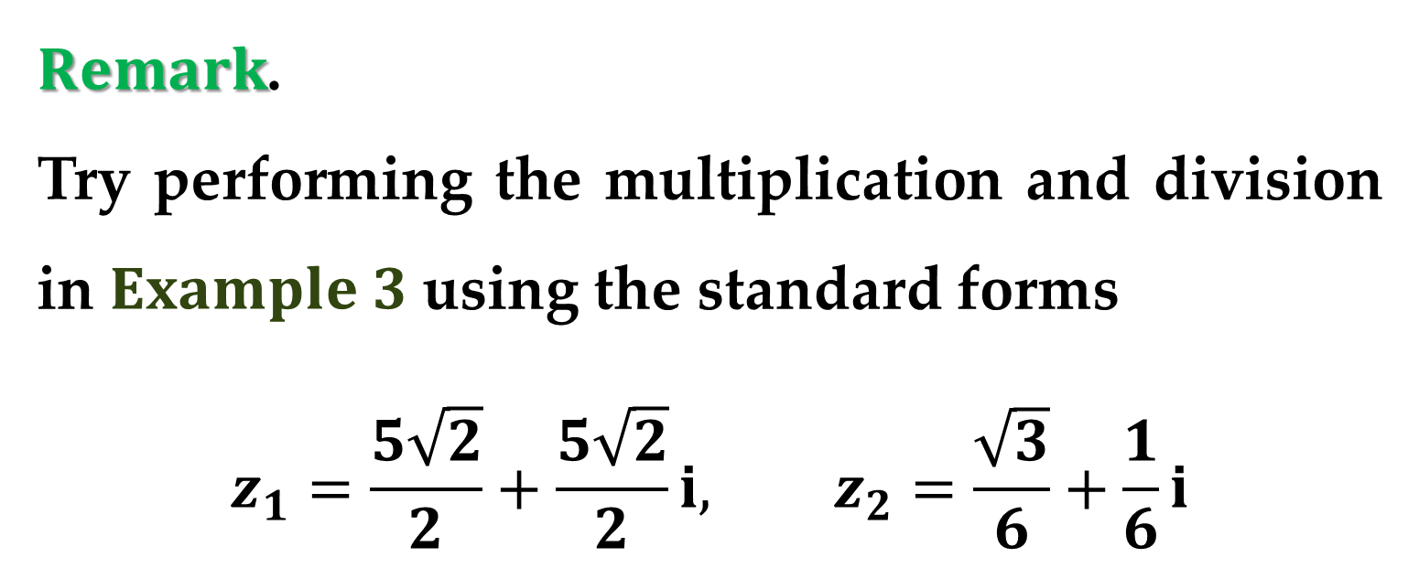
$Remark$.
Try performing the multiplication and division in $Example 3$ using the standard forms
$$z_{1}=\frac{5\sqrt{2}}{2}+\frac{5\sqrt{2}}{2}i, z_{2}=\frac{\sqrt{3}}{6}+\frac{1}{6}i$$

Slide 24
Complex Numbers –
DeMoivre’s Theorem

Slide 25
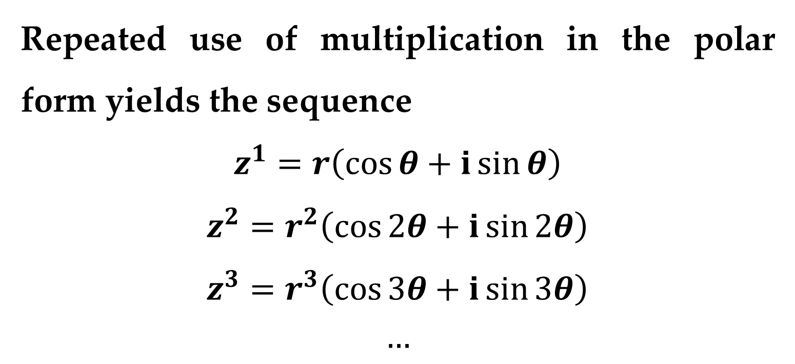
Our final topic in this lecture involves procedures for finding powers and roots of complex numbers.
Repeated use of multiplication in the polar form yields the sequence
$$z^{1}=r\left(\cos{θ}+i\sin{θ}\right)$$
$$z^{2}=r^{2}\left(\cos{2θ}+i\sin{2θ}\right)$$
$$z^{3}=r^{3}\left(\cos{3θ}+i\sin{3θ}\right)$$
$$…$$

Slide 26

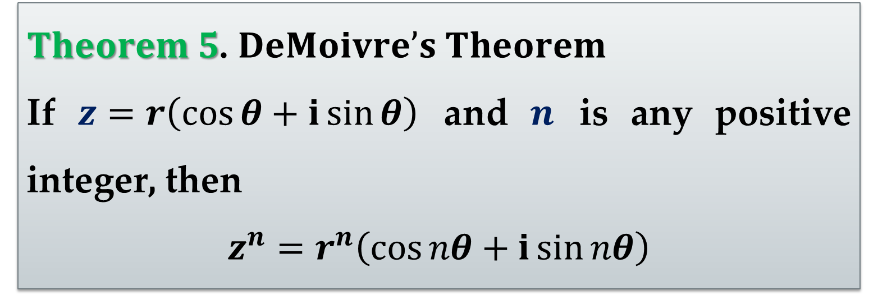
This pattern leads to the following important theorem, named after the French mathematician
Abraham DeMoivre (1667–1754).
$Theorem 5$. $DeMoivre’s Theorem$
If $z=r\left(\cos{θ}+i\sin{θ}\right)$ and $n$ is any positive integer, then
$$z^{n}=r^{n}\left(\cos{nθ}+i\sin{nθ}\right)$$
$Homework Assignment$: you are asked to prove this theorem.

Slide 27
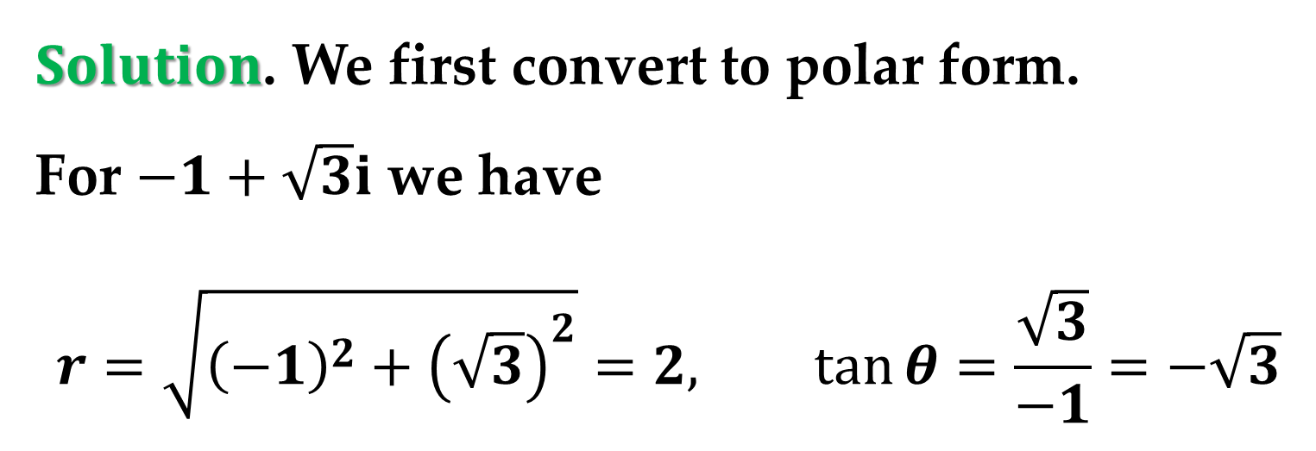
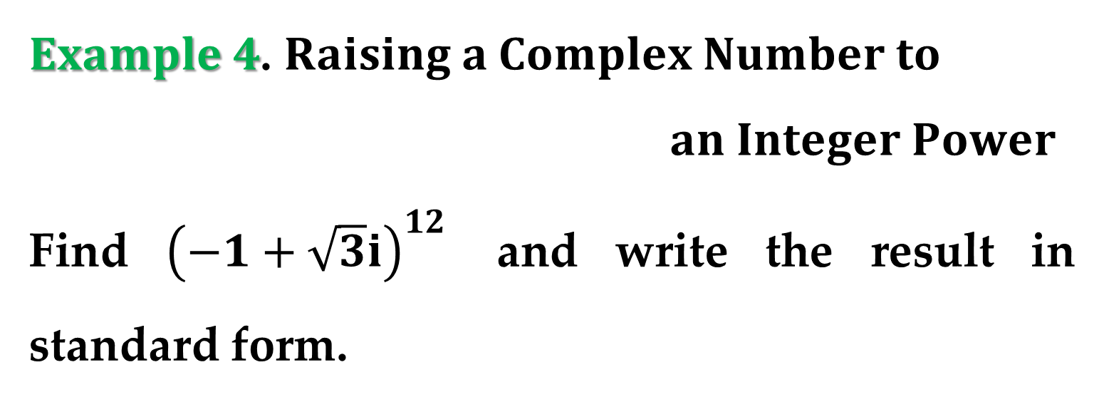
$Example 4$. $Raising a Complex Number to$
$an Integer Power$
Find ${\left(−1+\sqrt{3}i\right)}^{12}$ and write the result in standard form.
$Solution$. We first convert to polar form.
For $−1+\sqrt{3}i$ we have
$$r=\sqrt{{\left(−1\right)}^{2}+{\left(\sqrt{3}\right)}^{2}}=2, \tan{θ}=\frac{\sqrt{3}}{−1}=−\sqrt{3}$$

Slide 28
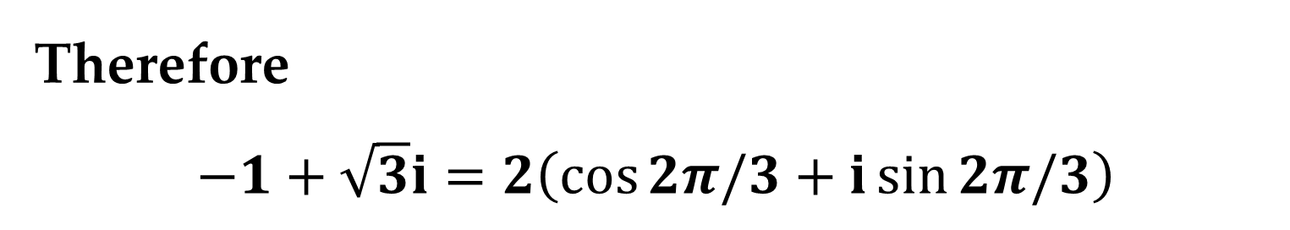

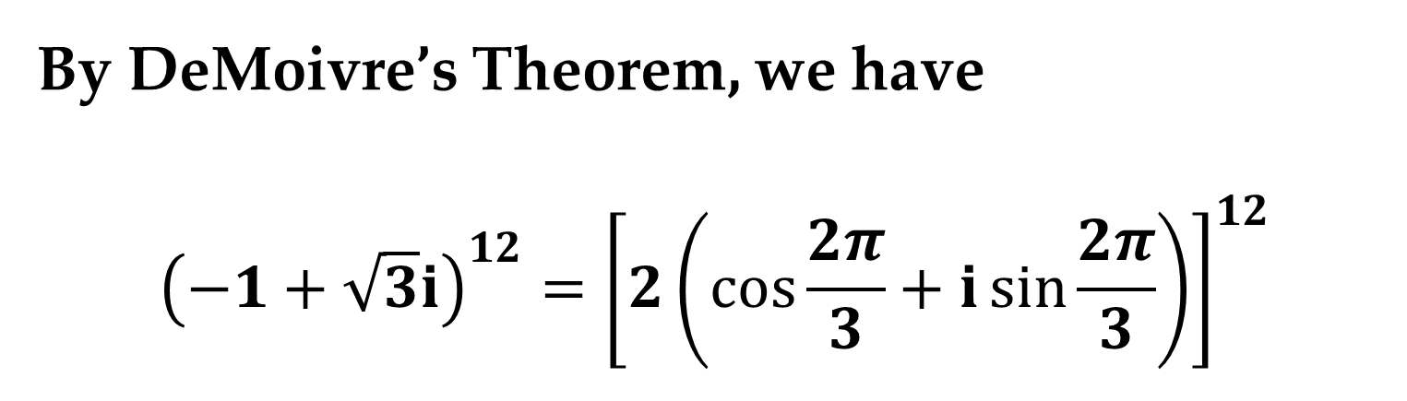
$Solution$. $\left(continued\right)$
This implies that
$$θ=2π/3$$
Therefore
$$−1+\sqrt{3}i=2\left(\cos{2π/3}+i\sin{2π/3}\right)$$
By DeMoivre’s Theorem, we have
$${\left(−1+\sqrt{3}i\right)}^{12}={\left[2\left(\cos{\frac{2π}{3}}+i\sin{\frac{2π}{3}}\right)\right]}^{12}$$

Slide 29
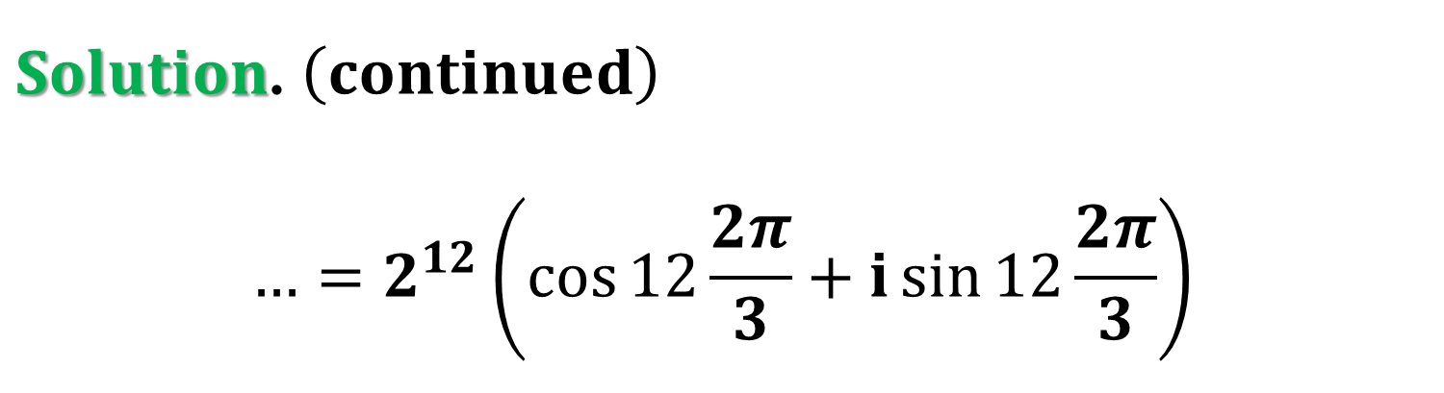
$Solution$. $\left(continued\right)$
$$…=2^{12}\left(\cos{12\frac{2π}{3}}+i\sin{12\frac{2π}{3}}\right)$$
$$=4096\left(\cos{8π}+i\sin{8π}\right)$$
$$=4096\left(1+i 0\right)=4096$$

Slide 30
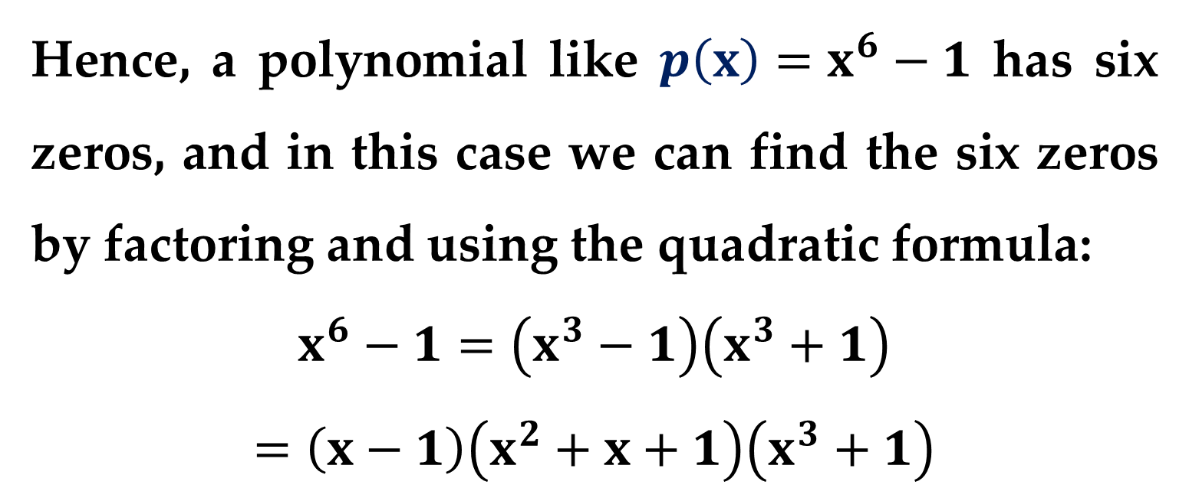
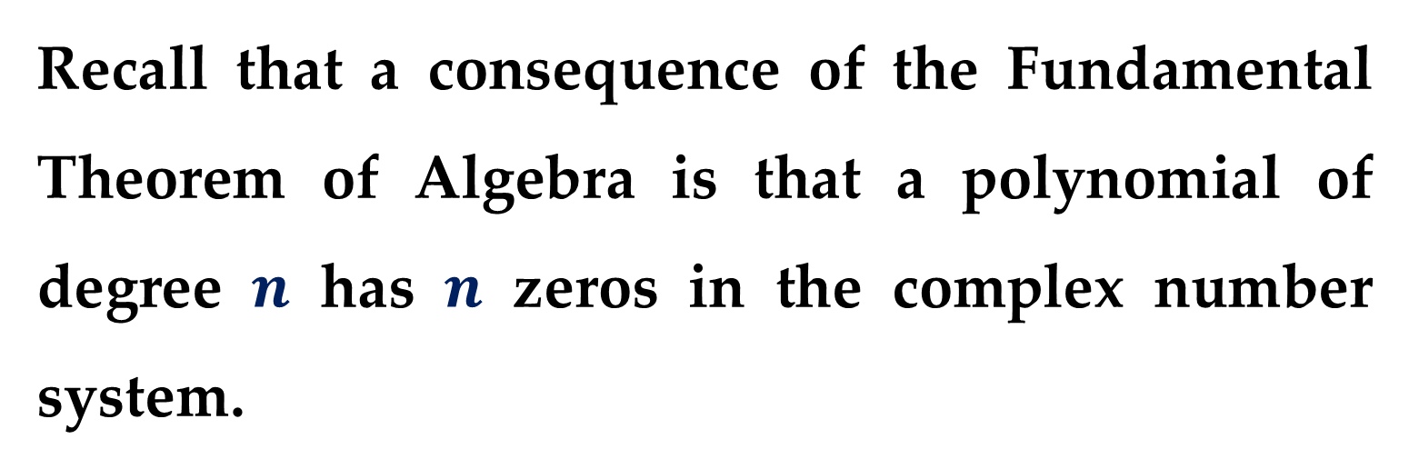
Recall that a consequence of the Fundamental Theorem of Algebra is that a polynomial of degree $n$ has $n$ zeros in the complex number system.
Hence, a polynomial like $p\left(x\right)=x^{6}−1$ has six zeros, and in this case we can find the six zeros by factoring and using the quadratic formula:
$$x^{6}−1=\left(x^{3}−1\right)\left(x^{3}+1\right)$$
$$=\left(x−1\right)\left(x^{2}+x+1\right)\left(x^{3}+1\right)$$

Slide 31

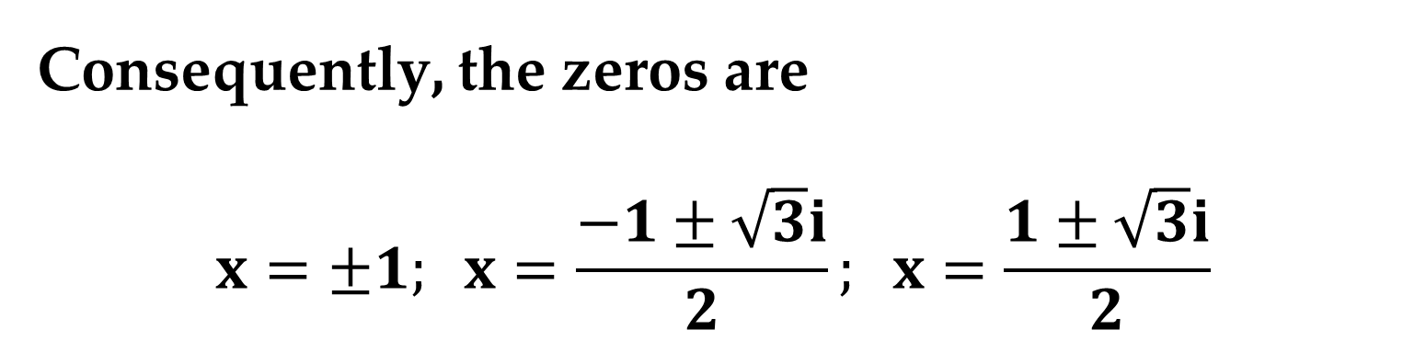
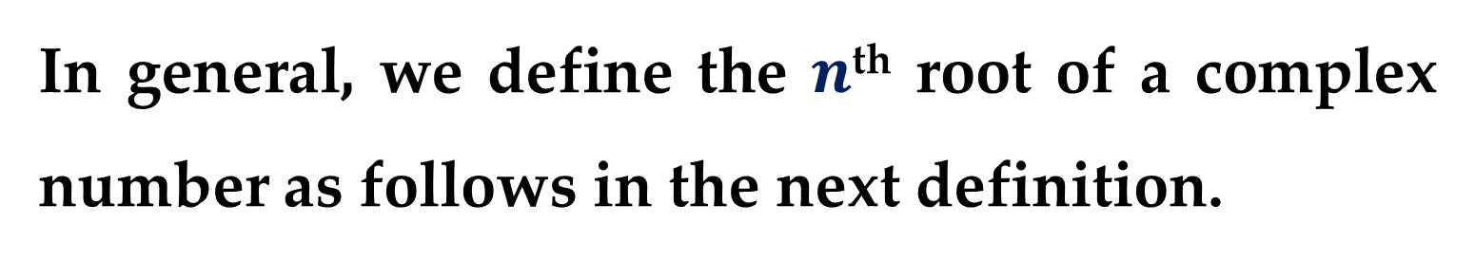
Consequently, the zeros are
$$x=±1; x=\frac{−1±\sqrt{3}i}{2}; x=\frac{1±\sqrt{3}i}{2}$$
Each of these numbers is called a sixth root of $1$.
In general, we define the $n$^{th} root of a complex number as follows in the next definition.

Slide 32
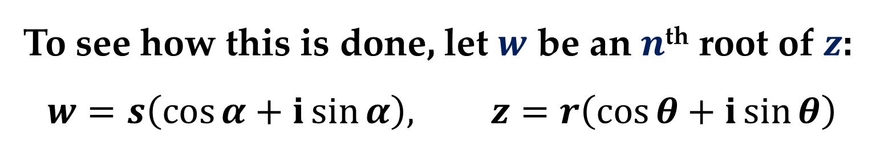
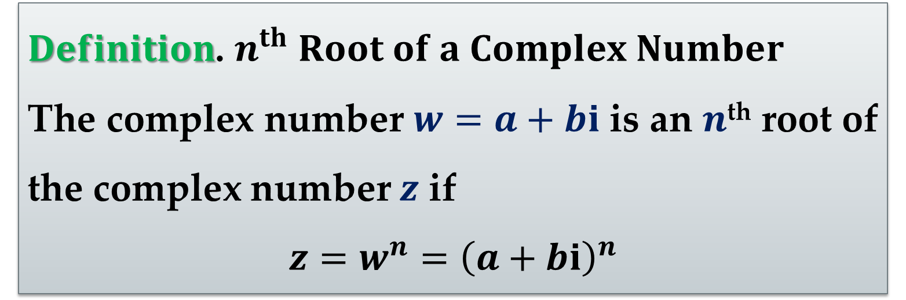
$Definition$. $n^{th} Root of a Complex Number$
The complex number $w=a+bi$ is an $n$^{th} root of the complex number $z$ if
$$z=w^{n}={\left(a+bi\right)}^{n}$$
DeMoivre’s Theorem is useful in determining roots of complex numbers.
To see how this is done, let $w$ be an $n$^{th} root of $z$:
$$w=s\left(\cos{α}+i\sin{α}\right), z=r\left(\cos{θ}+i\sin{θ}\right)$$

Slide 33
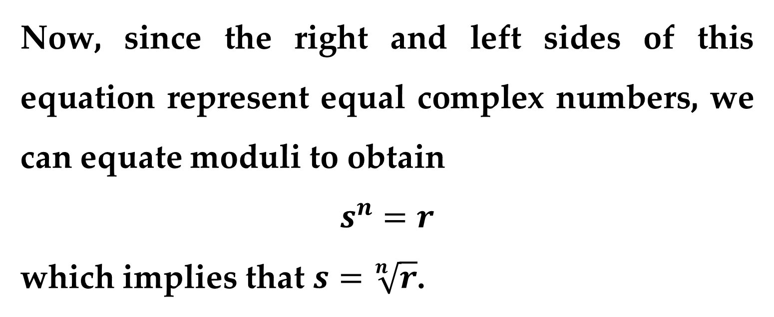
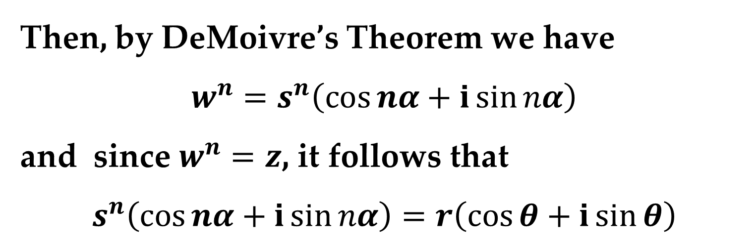
Then, by DeMoivre’s Theorem we have
$$w^{n}=s^{n}\left(\cos{nα}+i\sin{nα}\right)$$
and since $w^{n}=z$, it follows that
$$s^{n}\left(\cos{nα}+i\sin{nα}\right)=r\left(\cos{θ}+i\sin{θ}\right)$$
Now, since the right and left sides of this equation represent equal complex numbers, we can equate moduli to obtain
$$s^{n}=r$$
which implies that $s=\sqrt[n]{r}$.

Slide 34
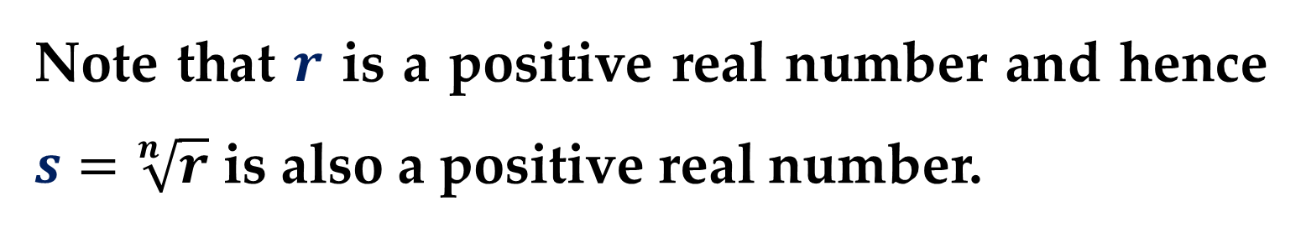


We also have to equate principal arguments to conclude that $θ$ and $nα$ must differ by a multiple of $2π$.
Note that $r$ is a positive real number and hence $s=\sqrt[n]{r}$ is also a positive real number.
Consequently, for some integer $k$, $nα=θ+2πk$ which implies that
$$α={\left(θ+2πk\right)}/n$$

Slide 35


Finally, substituting this value for $α$ into the polar form of $w$, we obtain the result stated in the following theorem.
$Theorem 6$. $n^{th} Roots of a Complex Number$
For any positive integer $n$, the complex number
$$z=r\left(\cos{θ}+i\sin{θ}\right)$$
has exactly $n$ distinct roots given by
$$\sqrt[n]{r}\left[\cos\left(\frac{θ+2πk}{n}\right)+i\sin\left(\frac{θ+2πk}{n}\right)\right]$$

Slide 36


$Remark$.
Note that the index $k$ takes on the values $0,1,2,…,n−1$, because when $k$ exceeds $n−1$, the roots begin to repeat.
For instance, if $k=n$, the angle is
$$\frac{θ+2πk}{n}=\frac{θ+2πn}{n}=\frac{θ}{n}+2π$$
which yields the same value for the sine and cosine as $k=0$.

Slide 37



The formula for the $n$^{th} roots of a complex number has a nice geometric interpretation, as shown in $Figure 4$.
Note that because the $n$^{th} roots all have the same modulus (length) $\sqrt[n]{r}$, they will lie on a circle of radius $\sqrt[n]{r}$ with center at the origin.

Slide 38



Furthermore, the $n$ roots are equally spaced along the circle, since successive $n$^{th} roots have arguments that differ by $2π/n$.
We have already found the sixth roots of $1$ by factoring and the quadratic formula.
Try solving the same problem using $Theorem 6$ to see if you get the roots shown in $Figure 5$ below.

Slide 39



When $Theorem 6$ is applied to the real number $1$, we give the $n^{th}$ roots a special name — the $n^{th} roots of unity$.
$Example 5$. $Finding the n^{th} Roots of$
$a Complex Number$
Determine the fourth roots of $i$.

Slide 40


$Solution$.
In polar form, we can write $i$ as
$$i=1\left(\cos{\frac{π}{2}}+i\sin{\frac{π}{2}}\right)$$
so that
$$r=1, θ=π/2$$
Then, by applying $Theorem 6$, we have
$$i^{1/4}=\sqrt[4]{1}\left[\cos\left(\frac{π/2}{4}+\frac{2kπ}{4}\right)+i\sin\left(\frac{π/2}{4}+\frac{2kπ}{4}\right)\right]$$

Slide 41


$Solution$. $\left(continued\right)$
$$…=\cos\left(\frac{π}{8}+\frac{kπ}{2}\right)+i\sin\left(\frac{π}{8}+\frac{kπ}{2}\right)$$
Setting $k=0,1,2,3$ we obtain the four roots:
$$z_{1}=\cos\left(π/8\right)+i\sin\left(π/8\right)$$
$$z_{2}=\cos\left({5π}/8\right)+i\sin\left({5π}/8\right)$$
$$z_{3}=\cos\left({9π}/8\right)+i\sin\left({9π}/8\right)$$
$$z_{4}=\cos\left({13π}/8\right)+i\sin\left({13π}/8\right)$$

Slide 42


$Remark$.
In $Figure 7$, note that when each of the four angles, $\frac{π}{8},\frac{5π}{8},\frac{9π}{8},\frac{13π}{8}$ is multiplied by $4$, the result is of the form
$\frac{π}{2}+2kπ$

Slide 43
Thank you for attention!

